Slide 1

To Manage CIP-007 R2 Requirements

Slide 2
requirements

Slide 3
Simple Compliance Story
Did you discover all security patches for CCA and make a decision on their application within 35 days?
For those CCA where patches are required, did you apply the patch within an additional 35 days?
For those CCA where patches are not going to be applied, did you publish a mitigation plan within an additional 35 days?

Slide 4
CIP 007 – R2 – Requirements*
Each Responsible Entity shall implement one or more documented process(es) that collectively include each of the following:
For applicable assets a process to:
Track Patches -- including documentation of patch sources
Evaluate Patches
Install Patches
At least once very 35 days, evaluate security patches for applicability
*Interpreted

Slide 5
CIP 007 – R2 – Requirements* (Cont.)
Within 35 days of evaluation completion the Entity must either:
Apply the patch
Execute a mitigation plan (new or revised) that is approved by the CIP Senior Manager and that includes actions and due dates for these actions The completion status of the mitigation plan action must be tracked. Revisions to the mitigation action competition schedule must documented as approved by the CIP Senior Manager.
*Interpreted

Slide 6
CIP 007 R2 Key Evidence
Documentation of the patch management process – tracking, evaluation, installation -- that includes a description of the software used in this process
Documentation of the life cycle of “applicable patches” with a focus on required actions within required timeframes.
Documentation that all security patches (1) were discovered, (2) were assessed with 35 days for applicability and (3) were implemented within an additional 35 days (OR) were addressed through a remediation plan which was developed within an additional 35 days.
List of BES Cyber Assets and Systems
List of sources monitored for security patches

Slide 7
End-of-Life Evidence (Last Patch Documentation)
Documentation that a patch or bulletin management process addresses end-of-life assets.
List of BES Systems/Assets at end-of-life a date that these assets were no longer vendor supported.
Documentation that latest available patch has been implemented OR that mitigating measures have been implemented for known vulnerabilities.

Slide 8
The business approach to patch management
All vendor security patches and bulletins that are applicable to TVA-owned CCA will be discovered and logged. (The tracking will also include patches where the security implications are not determined until the patch is assessed by the SME.)
CCA will be assigned to a Subject Matter Expert (SME) who is accountable for evaluating patch applicability for CIP compliance. This evolution also make the decision on patch vs. mitigate.
Applicable patches will be assigned to a Configuration Management Authority (CMA) who is accountable for either (1) planning, scheduling, implementing and documenting patch installation or (2) reviewing and concurring in the mitigation plan.
The openSPM system will be used to both manage the process and provide evidence of TVA’s compliance with 007-R2 requirements.

Slide 9


CIP-007 R2 Timed Process #1
Applicability Assessment
Patch released to TVA by vendor*
At least a weekly review process
Assessment Completed by SME (up to 35 days)
t = 0
t + 35 days
Patch Assessment Period
*TVA has elected assure prompt-patching by assigning the start of the 35-day assessment period as the date that the patch/bulletin was made available to TVA.

Slide 10
CIP-007 R2 Timed Process #2
Implement Patch – Develop Mitigation Plan
Identification
Plan Developed
Plan Close-out
Assessment
Acquisition
Deployment
Validation
Action Status
Testing
Mitigation Plan Action item completion documentation by CMA. (Period 3 – Untimed.)
Patch installation documented by CMA through their normal work management process.
Patch Assessment
Completed by SME.
Patch installation documented, OR Mitigation Plan developed by CMA.
t = 0
t + 35 days
Patch Action Period

Slide 11
The Mitigation Planning Process
Documentation of (1) the risk/impact of mitigation vs. on-time patching and (2) basis not applying the patch within “Period 2”.
Document specific compensating measures
Develop a plan for implementation of compensating measures and obtain plan approvals
SME developed plan with be “concurred in” by the CMA and approved by the CIP-007 Compliance Coordinator

Slide 12
Design approach

Slide 13
Application Purpose
The openSPM application will track:
The patches considered for applicability.
The date that the assessment process began and ended for each patch considered.
The date that:
An applicable patch was implemented (or)
The remediation plan was completed.
This application will be used by TVA:
Patch Intake Coordinators
Patch Subject Matter Experts
Configuration Management Authorities
The CIP 007-R2 Compliance Process Owner
Interested others / management

Slide 14
Patch Management Application Scope
This application is limited to meeting the immediate security patch management requirements for compliance with CIP-007-R2 for TVA control center and substation communications equipment. The application must be tested and ready to “go-live” May 1, 2016.
A “patch” means a either a change to software or software configuration as developed and disseminated by the software vendor and includes changes to software components (patches), system updates (new versions), and bulletins that address changes to configuration and/or software use.
Where convenient, the application will be generalized to support use by (in priority order), others in Transmission, other TVA business units and external organizations.

Slide 15
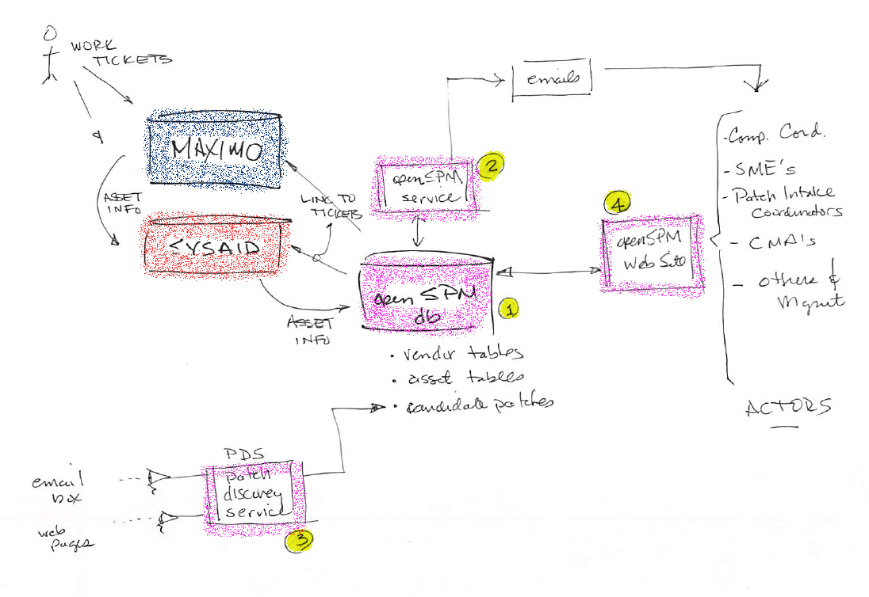
System Overview Diagram

Slide 16
openSPM Components
Data Base
openSPM Service
Website
Patch Discovery Service

Slide 17
openSPM Database
The data container that enables the other system components
Includes:
Connections to Maximo and SysAid
Cyber Asset List and SME/CMA owner
Vendor Lists
Candidate Patches / Applicable Patches
Approvals
Action date-times for compliance reporting

Slide 18
openSPM Service
Through evaluation of the openSPM database sends emails and copies of emails to specified staff and management to (among others):
Alert that patch work has been positioned that has compliance implications
Alert that compliance times are about to expire
Send period reports (e.g., weekly) on pending patch work

Slide 19
openSPM Patch Discovery Service
By “watching” email boxes, vendor web sites and local file shares among other automatization processes, the PDS will:
Discover candidate patches for review by SMEs as to their (1) security applicability and (2) TVA installed asset applicability
This service is separated from the openSPM service so that it can be positioned to be externally facing.

Slide 20
openSPM Website
This intranet site manage the life-cycle of a candidate patch recording the data necessary for providing evidence of compliance.
It will allow:
Patch Intake Coordinators to add candidate patches not discovered by the PDS.
SME’s to record the results of the patch assessment.
CMA’s to enter the ticket numbers of work packages opened to apply the patch
SMEs to upload mitigation plans
CMA’s to “sign-off” on patch deployement

Slide 21
Next steps

Slide 22
Recommended Actions
Begin work ASAP on a phased deployment of openSPM
Implement openSPM in two phases
Phase 1 – Proof of concept of core functionality. (March 4)
Phase 2 – Expansion of system to cover all CCA for all vendors for all actors in the compliance process. (April 15)

Slide 23
Phase 1 – Core Functionality – March 4
Build openSPM from best available data
CCA, CCA Vendors, Actors
Develop and test the patch discovery service by watching at least 1 email account and 1 vendor web site.
Develop the openSPM service that automatically sends primitive emails to actors based on (1) new work assigned to them and (2) compliance date approaching.
Develop a working prototype of the openSPM web site that includes tabs (screens) for each actor to log/report their compliance actions.

Slide 24
Phase 2 - Complete System – April 15
Go through several test / fix cycles by tracking real patches
Automate openSPM interaction with Maximo and SysAid to assure CCA lists are current across all systems
Expand PDS to include additional vendors
Refine openSPM service emails from both content and format perspectives
Document day 1 process (SPP) to assign accountably to Actors
Polish the web site adding role-based security Migrate all components to production – and include under their own configuration control

